Slide 1
MBARARA UNIVERSITY OF SCIENCE AN D TECHNOLOGY FACULY OF COMPUTING AND IN FORMATICS . BARCHELORS OF SCIENCE IN COMPUTERF SCIENCE
PROJECT NAME : BAKERY DATABASE MANAGEMENT SYSTEM.
PERSONAL AREA OF INTEREST: EMPLOYEE DATABSE SYSTEM .
LECTURER : KENETH BAGUMA
NAME : AGENGO ANNE MARIE CASMIRO
YEAR 1 : SEMESTER 2

Slide 2
BAKERY DATABASE SYSTEM TABLE OF CONTENT.
4.1.List of entities
4.2. List of entities and attributes
4.3.Enity of relationships
4.4. Add multiplicities to 4.3
4.5. User interface
5. Physical Design
5.1. Database Schema
5.2. Description of queries and reports
6. Implementing
1. Executive Summary
2. Database Project
2.1. Area of interest
2.2. Possible Database systems
2.3 . Reason for the Area of interest
3. Business case
3.1. Application Domain
3.2 . Analysis of Benefits
3.3. Analysis of costs
3.4 . User issues
3.5. Risk Assessment
3.6. Limitations
4.Databse Design

Slide 3
Executive Summary
This project details the implementation of a database management system for a Bakery . This system enables us to handle different databases involved in bakery database management system . It ensures efficient and effective day to day running in a bakery such orders, or transactions.
The report outlines the business case including the application domain, benefits, costs ,user issues , analysis, risks and limitations. More so, it shows designs including logical and physical designs. Logical designs include entities , attributes, relationships, and entity relationship (ERD). The physical design shows the database schema and sample queries.
Finally, the report showcases the system’s implementation in MSQL, including screenshots, table descriptions and sample queries.

Slide 4
Database Project is for a bakery Area of interest is Employee database system.
Possible database systems ;
Supplies
Inventory
Customer
Orders
Employee
I chose an employee database to ensure that employees are paid on time and to handle employee issues such as complaints of employees.

Slide 5
Application Domain
Analysis of Benefit
Tangible Benefits
It can reduce loss of information where paper is used.
It can reduce wastage of raw materials in such keeping track of deliveries.
The system reduces on the number of employees since it does most of the work.
Intangible benefits
Enhanced customer loyality. This allows strong customer preferences enabling tailored service and personalised promotions.
Improved brand representation. This helps maintain high quality and standards and consistent product availability.

Slide 6
Analysis of cost
Tangible cost
Acquisition costs . There are expenses when acquiring assets for a bakery system such vehicles , premises.
Operational cost . This includes the day to day expenses of the bakery such as purchase of raw materials .
Marketing and advertising costs . His includes promotional costs of products such as new cake flavors on the menu .
Intangible cost
Resistance to change : staff members who are rigid to paper work may find it difficult to adopt to the digital system.
System dependency . Increased vulnerability of the bakery if the system goes down . Staff may struggle to fulfill orders or keep track of deliveries .

Slide 7
User Issues
Data Integrity and Input Issues
A database is only as good the information put into it . These may include;
Inconsistent data entry . One user may enter “ chocolate Cake “,while another one wants “ Choc. Cake(Large )”.This creates duplicate issues .
Inventory Lag : If a baker uses 10kg of flour but forgets to staff stock log out , the system will show an incorrect balance , leading to a shortage during production .
Operational and security and issues
. Dependency issues if the system goes offline . The staff may lack a back up plan .If they don’t know the prices by heart , operations may grind to a halt .

Slide 8
Risk Assessment This involves identifying potentials threats to the data , the hardware and business operations, then evaluating the likelihood and impact of those threats .
Technical and Data Risks
.Data Loss . Data may lost incase if the system fails or shuts down
.
Security and cyber risks
.Hazard : Hybrid Cyber –Threats

Slide 9
Continued Risk Assessment
Operational Risks
Concurrency issues : If two members try to update stock of the last ingredient for example sugar at the exact time , the database must be able to handle that collision without crushing .
Recipe consistency : If a database update fails halfway through , you might end up with jambled data where an ingredient is deleted from inventory but not added to production costs .
Security Risks (Data Protection)
This involve protecting sensitive information from internal and external threats.
Unauthorized access: A seasonal employee might accidentally see the bakery’s profit margins or change or proprietary recipe.
Payment Security : Storing credit card information or bank account information directly in your database is a massive risk .

Slide 10
Risk | Likelihood | Impact | Mitigation Strategy
Hardware Failure | High | Moderate | Use fanless PCs or protective enclosures
Accidental Data Deletion | Moderate | High | Implement “ Soft Deletes “ and regular backups.
Cyber Attack | Low | Very high | Use strong passwords

Slide 11
How to conduct Risk Assessment
Identify Assets : List what needs protecting such as customer list, Secret Recipes , Inventory , Employees, Supplies.
Implement Controls : Set up firewalls, backups, and user permissioons to reduce the risks identified.
Analyze Impact : If the “Recipe “ table was deleted , how long would it take to recover .
Identify threats : What would or could go wrong ? Such as fire , human error, theft.

Slide 12
Limitations
Data loss is unavoidable.
Semi skilled labour
Technical Complexity.

Slide 13
Summary of Limitations
Limitation | Type | Impact
Environmental Vulnerability | Physical | High risk of hardware failure due to dust / heat
Data Entry Lag | Human | Inventory numbers are often “behind” real –time stock.
Complexity | Operational | Requires ongoing technical skills To manage and update

Slide 14
List of entities
Supplies
Inventory
Customer
Orders
Employee

Slide 15
List of entities and Attributes
Supplies [ Supplier ID (primary key ) , Supplier name , Contact Person Name , Phone Number, Email Address , Physical Address , Payment Terms ].
Customers[ Customer ID (Primary key ), Full name, Email Address , Dietary Preferences ,].
Orders[ Order ID (Primary Key ), Order date , Customer ID ( Foreign key to link the buyer ) , Employee ID ( Foreign key to track who processed the sale ), Payment Status( such as Paid, Pending, Refunded), Order type ( such as Take away , Custom cake Delivery) ].
Inventory [ Inventory ID(Primary key ), Item Name ( such as butter), Current quantity , Unit of measure , Expiry Date , Storage location ].
Employees[ Employee ID (Primary key), First name and last name , Role ( such as Pastry chef , Cashier, Head Baker, Contact number and email Address , Hire Date , Salary.]

Slide 16
Entity Relationship
Customers and orders ( One to Many ) [ 1: N]
Employees and orders ( one to many ) [1: N]
Inventory and supplies ( many to many ) [M: N]
Orders and inventory (many to many ) [ M: N]

Slide 17
Summary of Relationship Table
Relationship | Type | Description
Customer to Order | 1: N | A customer makes multiple Purchases.
Employee to Order | 1:N | A staff member handles many sales .
Supplier to Inventory | M:N | Vendors supply multiple items ; items come from various vendors
Order to Inventory | M:N | Orders consists of many items ; items are part of many orders.

Slide 18
Employee Database System Physical Design
Table Employees
Employee ID (INT, Primary key, Auto _ increment
FirstName (VARCHAR(50),NOT NULL)
LastName (VARCHAR(100),Unique)
Hire Date(DATE )
Status (‘On Leave’)
Department ID (INT Foreign Key)
Table Leave Records
Leave ID (INT, Primary Key Auto _ increment)
Employee ID ( INT , Foreign Key references Employees)
Leave Type (ENUM(‘Sick’, ‘Vacation ’ , ’Maternity’, ‘ ‘Unpaid ‘) )
Start Date (DATE )
End Date(DATE)
Status (ENUM(‘ Pending’ , ‘Approved ‘, ‘Rejected’ ))

Slide 19
Physical Design continued;
Table Payroll
Pay roll ID (INT , Primary Key Auto _ Increment )
Employee ID (INT, Foreign Key )
Pay Period End Date NOT NULL
Table Roles
Role ID INT Primary Key Auto _ Increment
First Name VARCHAR(50) NOT NULL
Last Name VARCHAR(50) NOT NULL
Email Address VARCHAR(100) Unique
Hire Date (DATE)

Slide 20
Personal Area of interest Employee database System . Entities and attributes
Roles [ Role ID (Primary key),Job title, Department, Sales]
Employees[ Employee ID (Primary key), First name , Last name , Role ID]
Payroll [ Payroll ID (Primary key),Employee ID , Account Number, Bank name, Foreign key]
Leave Records [Leave ID , (Primary key), Start date, End date, Foreign key]

Slide 21
Roles
Employees
Payroll
Role ID (FK)
Pay Roll ID
Role ID
Role Name
Department
BaseSalary
First Name
Last Name
Hire Date
Role ID (FK)
Employee ID (FK)
Account Number
Leave RECORDS
ERD for my Employee database system
Leave ID
Employee ID (FK)
Leave TYPE , Start Date, End Date, Status

Slide 22
Summary of the relationships
From | TO | Relationship | Meaning
Roles | Employees | One to many | One to many employees
Employees | Payroll | One to many | One employees to many payroll records
Employees | Leave Record | One to many | One employee to many leave requests

Slide 23
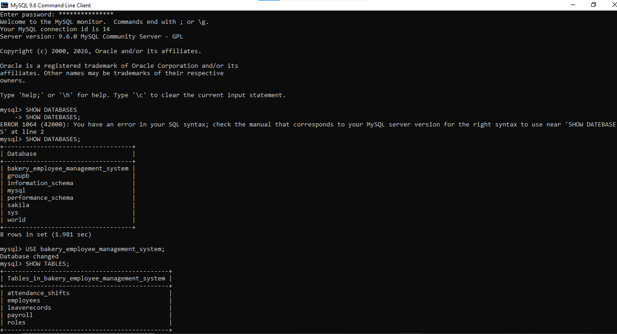

Slide 24
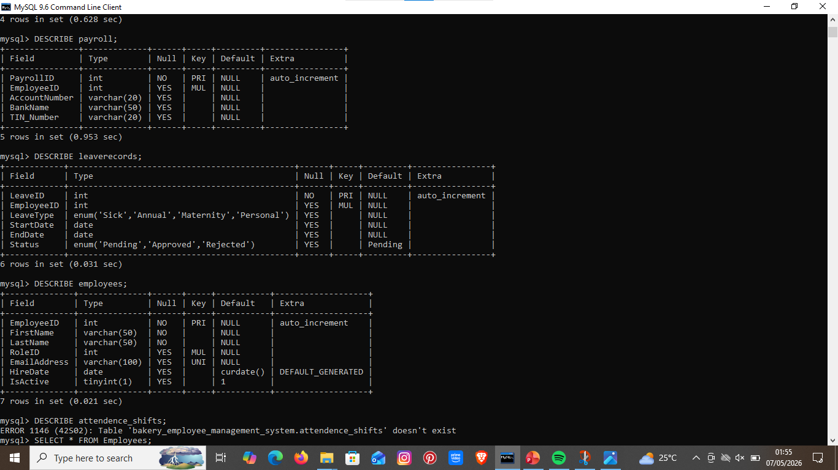

Slide 25
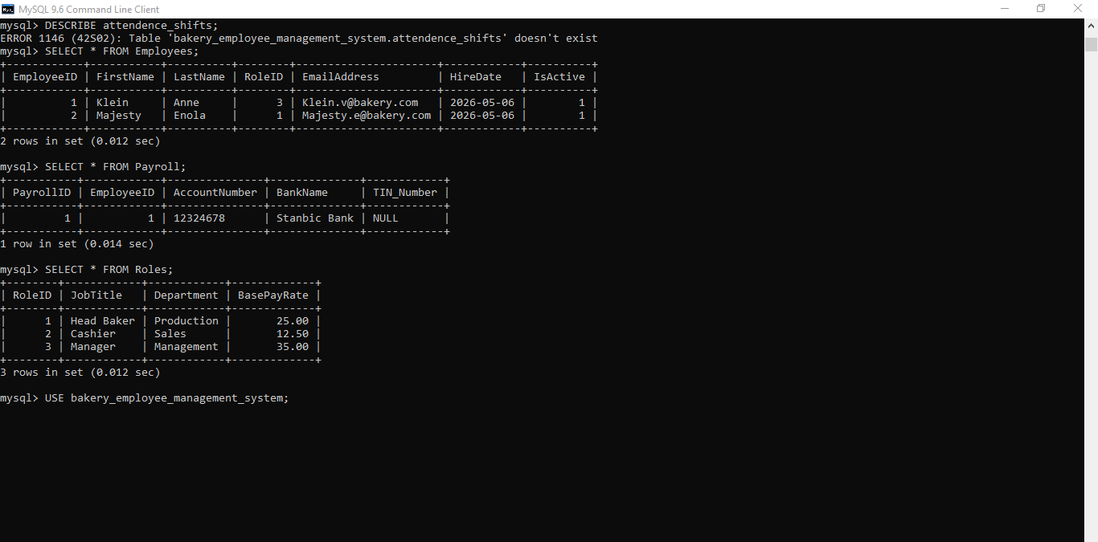

Slide 26
Description of queries and Reports . The key queries generated by this system include the following
1. Described Employee
2. Showed tables in my system.
3. Created Table Roles [ role ID, Job title]
Selected * from Roles;
Showed Databases
Showed Tables
Showed that errors also existed

Slide 27
Inclusion the system shows that we can access and make payment to employees , know when they are on leave .

